Slide 1
CSE 417T Introduction to Machine Learning
Instructor: Chien-Ju Ho

Slide 2
Plan for Today
Welcome and introduction
What’s the class about?
Logistics
Lecture
Setting up the learning problem
Perceptron learning algorithm

Slide 3
What is Machine Learning?

Slide 4
What Machine Learning Can Do?

Slide 5

Example: Credit Card Approval
Input: customer information
age
gender
salary
debt
years in job
years at home
. . .
32 years male 40,000
26,000
1 year
3 years
. . .
A brute-force solution
Build a large table that maps all possible attribute combinations to a prediction
Not really feasible at scale
Possible attribute combinations could be infinite
Storage, computation
How to come up with the table?
Output: a prediction
Will the customer be a good customer for the bank?

Slide 6
A ”Machine Learning” Approach
Hypothesis / Model (Some math function)
Data (Historical Customer Data)
Find a hypothesis that “fits” the data (The process requires a lot of computation)

Slide 7
A ”Machine Learning” Approach
The main ideas are there for several decades
Why is it getting so much attention now?
Data: Availability of a huge amount of data
Computation: Computation power catches up
Example: ImageNet
Utilize internet users to label more than 14 millions of images
This is where Deep Learning starts to gain attention

Slide 8
What is Machine Learning?
“learning from data”
“using a set of observations to uncover an underlying pattern”
Use scenarios of machine learning
A pattern exists
No analytical solution: We cannot pin it down mathematically
We have data on it

Slide 9
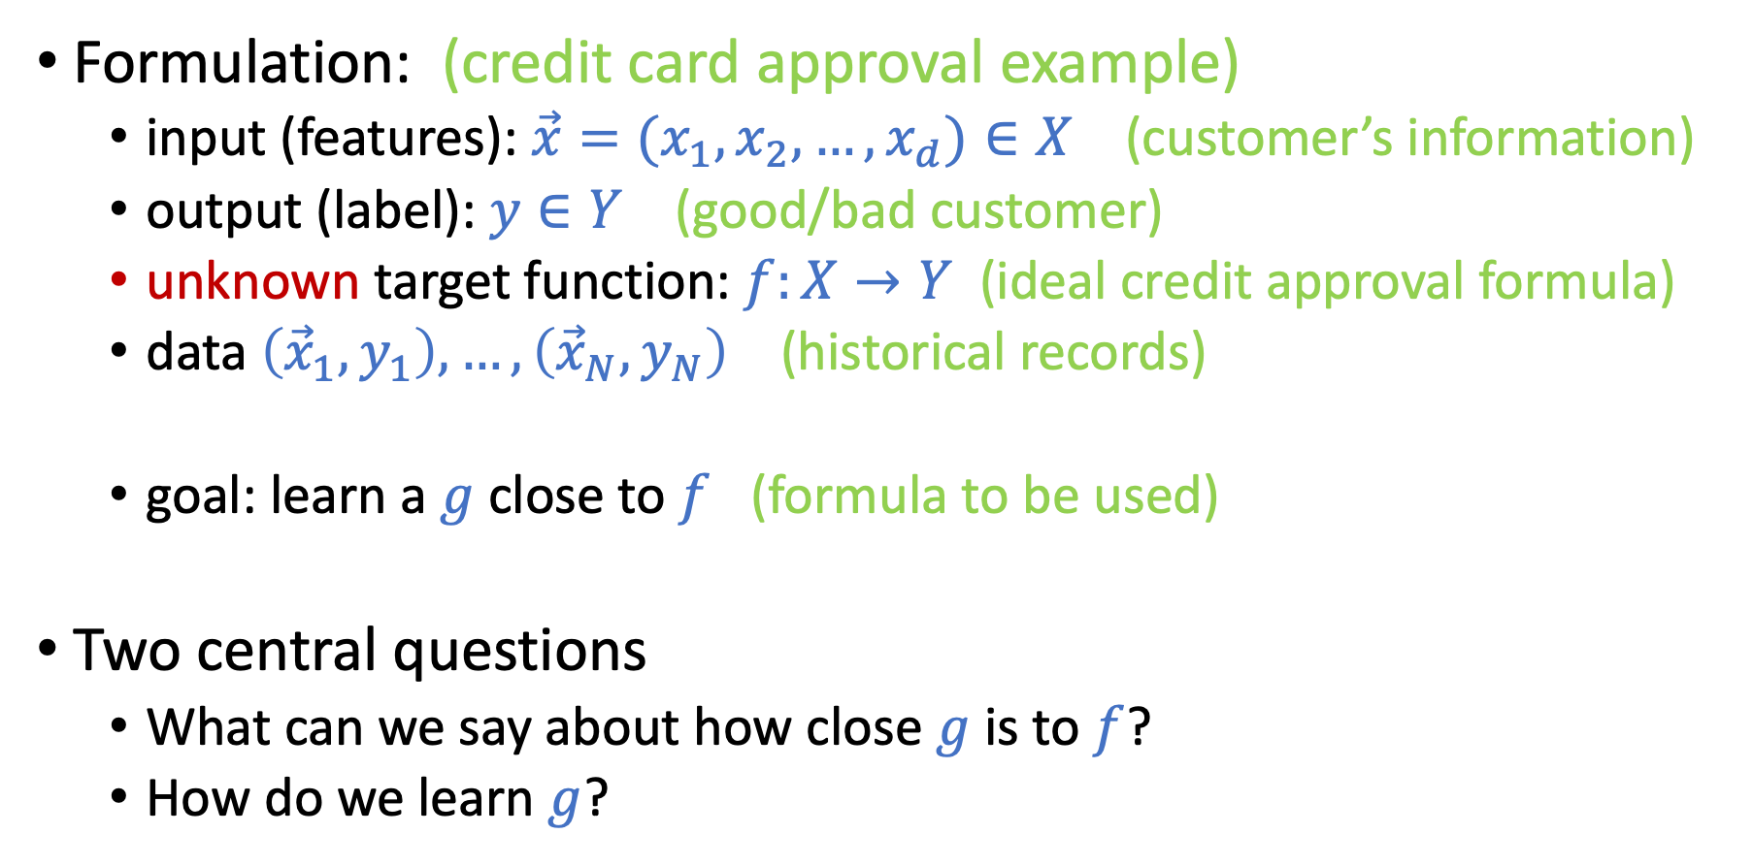
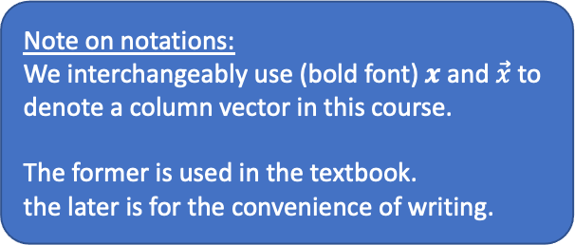
More Formally (For Supervised Learning)
Formulation: (credit card approval example)
input (features): $\vec{x}=(x_{1},x_{2},…,x_{d})∈X$ (customer’s information)
output (label): $y∈Y$ (good/bad customer)
unknown target function: $f:X→Y$ (ideal credit approval formula)
data $\left({\vec{x}}_{1},y_{1}\right),…,\left({\vec{x}}_{N},y_{N}\right)$ (historical records)
goal: learn a $g$close to $f$ (formula to be used)
Two central questions
What can we say about how close $g$is to $f$?
How do we learn $g$?
Note on notations:
We interchangeably use (bold font) $x$ and $\vec{x}$ to denote a column vector in this course.
The former is used in the textbook. the later is for the convenience of writing.

Slide 10
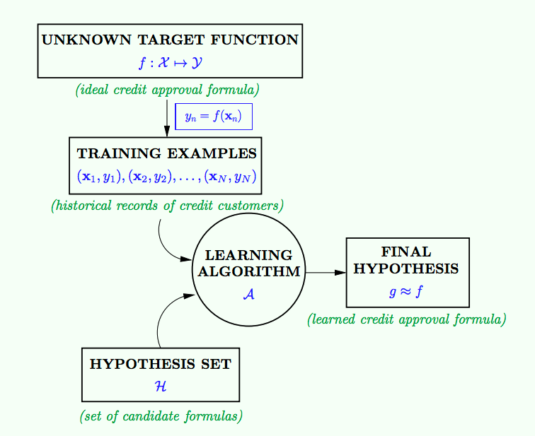
Given by the learning problem
Goal of learning

Slide 11
Given by the learning problem
Goal of learning

Slide 12
learning model

Slide 13
Course Plan
First half of the semester: Foundations
Focus on linear models
Fundamental components of many other models
Discuss the theoretical foundations of machine learning
Heavy use of probability, linear algebra, and optimization
Second half of the semester: Techniques
Discuss different learning models

Slide 14
Course Plan
Foundations
What’s machine learning
Feasibility of learning
Generalization
Linear models
Non-linear transformations
Overfitting and how to avoid it
Regularization
Validation
Techniques
Nearest neighbors
Decision tree
Support vector machine
Boosting
Random forest
Neural networks
…

Slide 15
Types of Learning
Supervised learning (the focus of this course)
Given training data (input, correct output)
Try to predict the output for data not seen before
Unsupervised learning
Given data in the form of (input)
Find patterns in data
Reinforcement learning
Learn how to act, based on rewards for actions

Slide 16
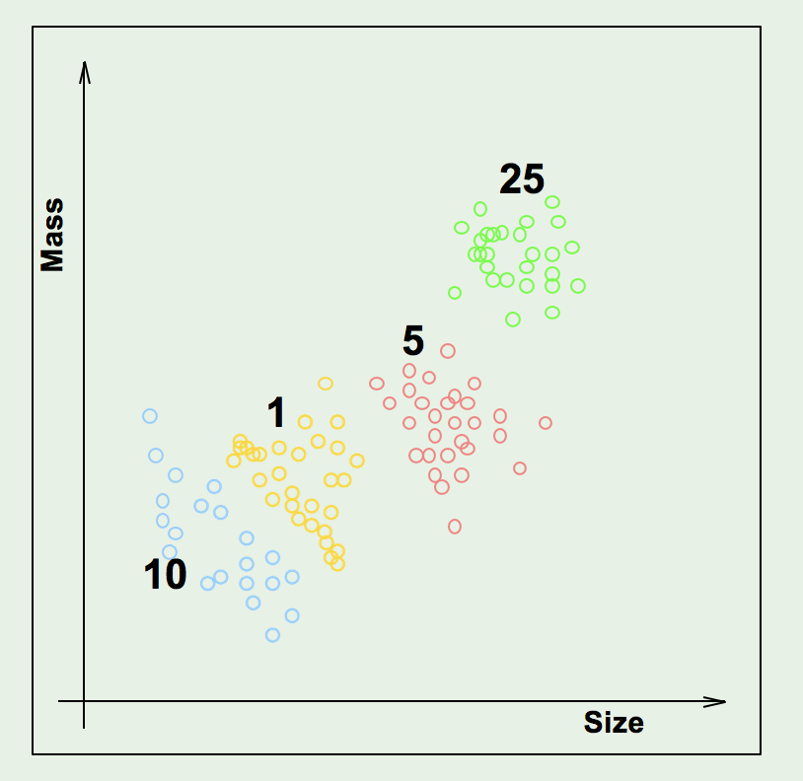
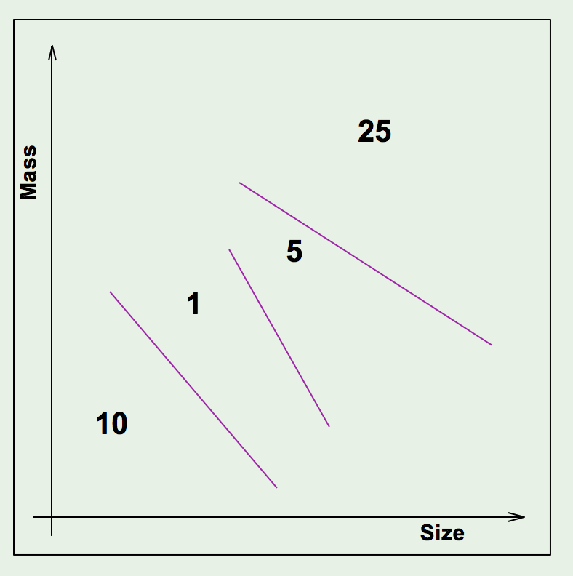
Supervised Learning
Given data with (input, correct output), learn a pattern that can predict previously unseen data

Slide 17
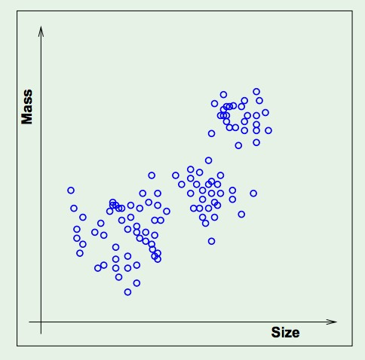
Unsupervised Learning (more in 517A)
Suppose you only have the feature vectors but no labels. Still want to describe the data in some useful way.

Slide 18
Reinforcement Learning (more in 412A)
Agent interacts with the world by taking actions
Feedback is in the form of rewards (or costs)
Agent must learn a policy, which maps from the state of the world to an action
Major challenges:
Exploration / exploitation
Delayed reward / credit assignment

Slide 19
Course plans (focus on supervised learning)

Slide 20
Logistics
Websites
Course website: http://chienjuho.com/courses/cse417t
Piazza for discussion
Gradescope for homework submissions
You are responsible for following the announcements on website and Piazza
TA and Office Hours
There will be several graduate/undergraduate TAs
Office hours will be announced in the 2nd week and start in the 3rd week

Slide 21
Course Information: Textbooks
Learning From Data
Y. Abu-Mostafa, M. Magdon-Ismail, and H-T Lin.
http://amlbook.com/
We will go through this book in the first half of the semester.
Computer Age Statistical Inference: Algorithms, Evidence, and Data Science.
B. Efron and T. Hastie
https://web.stanford.edu/~hastie/CASI/
We will reference a few sections as the course materials. The PDF file is freely available on their website

Slide 22
Course Information: Grading
Homework assignments (5 to 6): 50%
Mix of programming and pencil-and-paper problems
Worst score discounted by 50%
Programming language: Python
We don’t teach how to program Python
5 total late days, no more than 2 on any one assignment
Two exams: 50% (25% each)
One in the middle of the semester (sometime in mid-to-late October)
One on the last lecture of the semester
Each exam covers around half of the materials. No separate final exam.
More details will be announced later

Slide 23
Course Information: Academic Integrity
Take a look at the syllabus
Collaborations
You are encouraged to discuss homework with other students
Must write your own solutions
Must cite all external sources (including other students)
Other accommodation resources
Academic integrity
Zero tolerance on the violation
Will be reported to the university
There will be permanent record if found guilty

Slide 24
Course Information
Questions not covered in the syllabus?
Ask me!
Generally, I don’t grant individual exceptions
Can I do extra work to get more points?
I have another exam this week, can I get an additional day for the assignment?
I work really hard but can’t finish the assignment on time. Can I get an additional day for the assignment?
I work really hard. Can I get higher grades?
No to all the above.
Exceptions: family/medical emergencies
Rule of thumb:
I only say yes if I feel comfortable giving the same treatment to everyone in the class.

Slide 25
Getting in Touch
Please use Piazza as the main communication channel
Emails will likely not be responded
Use public posts in Piazza by default
Other students might have the same questions
Other students might help answer the questions
When to use private posts
The questions involve disclosing your answers to the homework
Most of the time, you can reframe your questions to avoid this
The questions are about your personal matter

Slide 26
Is This Course for You?
This is going to be a very theory-heavy course
The “T“ in CSE 417T stands for “Theory”
There will be A LOT OF math!
We focus on understanding the foundations of machine learning
If your main goal is to learn how to apply ML to solve problems, this might not be the best course for that.
Check out CSE 217A, CSE 412A, ESE 417, BME 440, INFO 558

Slide 27
Is This Course for You?
Try homework 0 (posted on the website)
A subset of questions in homework 1.
You should feel comfortable working on these kinds of questions.
You should be ready to answer all questions there after the lecture today.
If you are on the waitlist and want to get enrolled:
Complete homework 0
A mixture of math and programing questions
Explain why you want/need to take this course in this semester
Submit via Gradescope by noon next Tuesday (Sep 6)
Priorities will be given to students who benefit the most by taking this course this semester (condition on having satisfactory answers to the questions)
If you are enrolled:
Don’t submit homework 0 yet, but you should check it out as well
The same questions will appear in homework 1
It helps you get a better sense of what this course is about

Slide 28
Waitlist and Enrollment
If you are on the waitlist and want to get enrolled:
Complete homework 0 (posted on the website)
Prove Chebyshev's inequality, one form of the law of large numbers
Prove PLA (discussed next) converges in finite steps
Implement PLA and observe its empirical performance
Explain why you want/need to take this course in this semester
Submit via Gradescope by noon next Tuesday (Sep 6)
Priorities will be given to students who benefit the most by taking this course this semester (condition on having satisfactory answers to the questions)
If you are enrolled
You should look at homework 0 as well (please don’t submit yet)
It helps you get a better sense of what this course is about

Slide 29
Questions?

Slide 30
Lecture Today

Slide 32

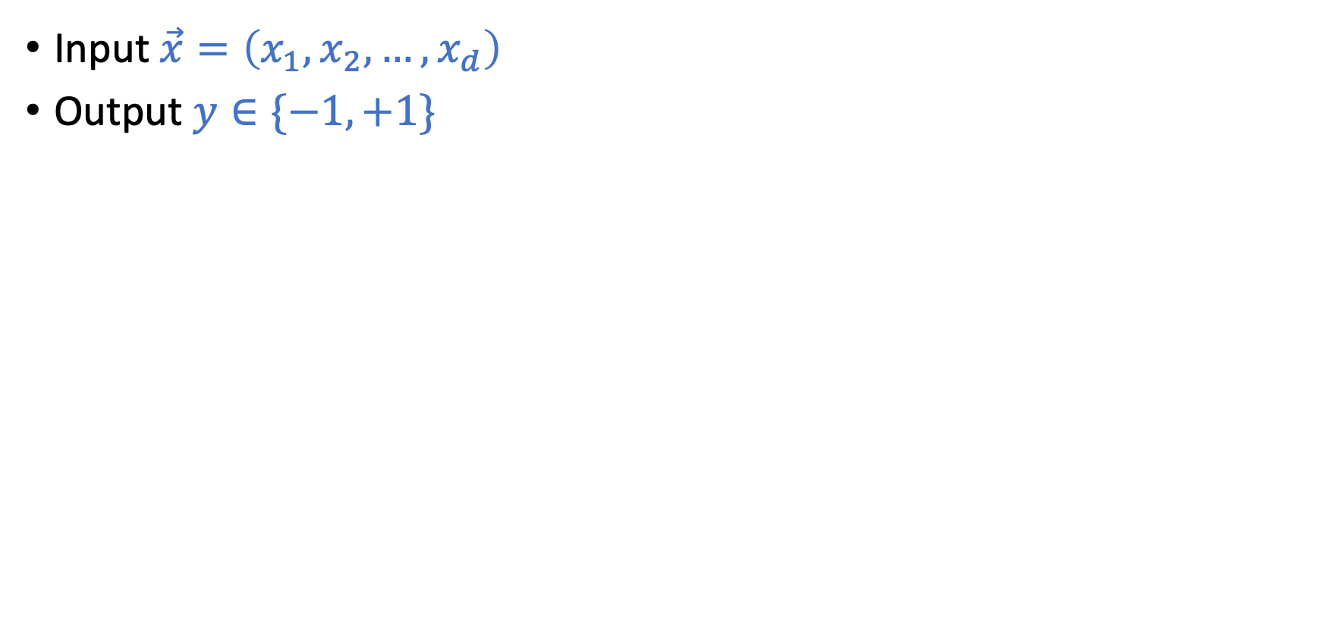
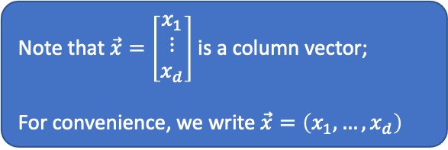
Linear Hypothesis Space (Perceptron)
Note that $\vec{x}=\left[\begin{matrix}x_{1} \\ ⋮ \\ x_{d}\end{matrix}\right]$ is a column vector;
For convenience, we write $\vec{x}=\left(x_{1},…,x_{d}\right)$
Input $\vec{x}=\left(x_{1},x_{2},…,x_{d}\right)$
Output $y∈\{−1,+1\}$

Slide 33
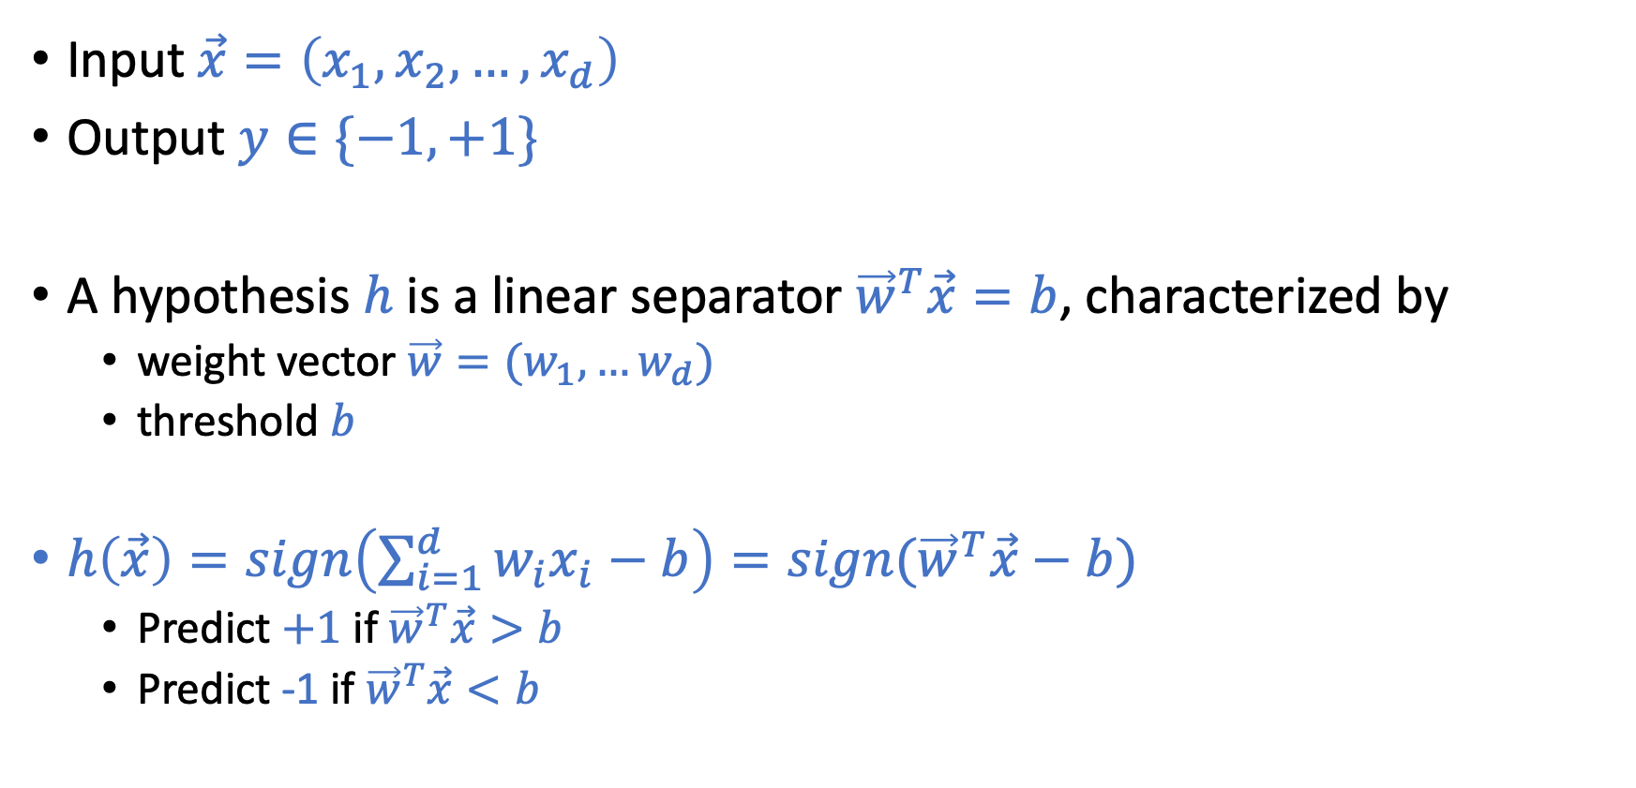
Linear Hypothesis Space (Perceptron)
Note that $\vec{x}=\left[\begin{matrix}x_{1} \\ ⋮ \\ x_{d}\end{matrix}\right]$ is a column vector;
For convenience, we write $\vec{x}=\left(x_{1},…,x_{d}\right)$
Input $\vec{x}=\left(x_{1},x_{2},…,x_{d}\right)$
Output $y∈\{−1,+1\}$
A hypothesis $h$ is a linear separator ${\vec{w}}^{T}\vec{x}=b$, characterized by
weight vector $\vec{w}=(w_{1},…w_{d})$
threshold $b$
$h\left(\vec{x}\right)=sign\left(\sum_{i=1}^{d}{w_{i}x_{i}}−b\right)=sign({\vec{w}}^{T}\vec{x}−b)$
Predict $+1$ if ${\vec{w}}^{T}\vec{x}>b$
Predict -1 if ${\vec{w}}^{T}\vec{x}<b$

Slide 34
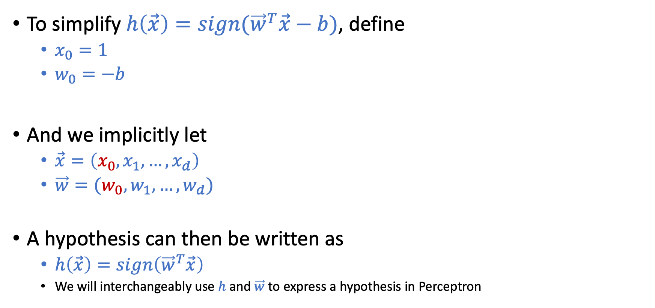
Linear Hypothesis Space (Perceptron)
To simplify $h\left(\vec{x}\right)=sign({\vec{w}}^{T}\vec{x}−b)$, define
$x_{0}=1$
$w_{0}=−b$
And we implicitly let
$\vec{x}=\left(x_{0},x_{1},…,x_{d}\right)$
$\vec{w}=(w_{0},w_{1},…,w_{d})$
A hypothesis can then be written as
$h\left(\vec{x}\right)=sign\left({\vec{w}}^{T}\vec{x}\right)$
We will interchangeably use $h$ and $\vec{w}$ to express a hypothesis in Perceptron

Slide 35
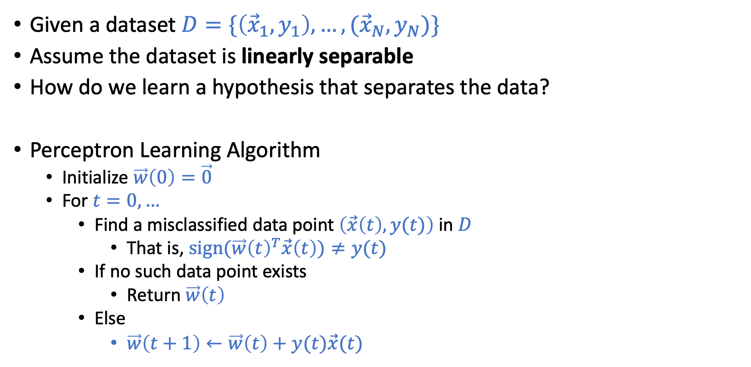
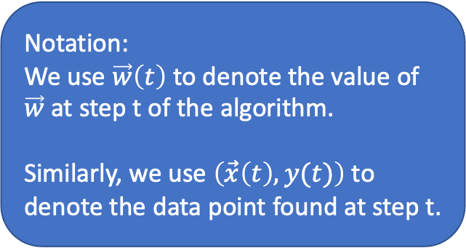
Perceptron Learning Algorithm (PLA)
Given a dataset $D=\{\left({\vec{x}}_{1},y_{1}\right),…,({\vec{x}}_{N},y_{N})\}$
Assume the dataset is linearly separable
How do we learn a hypothesis that separates the data?
Perceptron Learning Algorithm
Initialize $\vec{w}\left(0\right)=\vec{0}$
For $t=0,…$
Find a misclassified data point $\left(\vec{x}\left(t\right),y(t)\right)$ in $D$
That is, $sign(\vec{w}{\left(t\right)}^{T}\vec{x}\left(t\right))≠y(t)$
If no such data point exists
Return $\vec{w}\left(t\right)$
Else
$\vec{w}\left(t+1\right)←\vec{w}\left(t\right)+y(t)\vec{x}(t)$
Notation:
We use $\vec{w}\left(t\right)$ to denote the value of $\vec{w}$ at step t of the algorithm. Similarly, we use $\left(\vec{x}\left(t\right),y(t)\right)$ to denote the data point found at step t.

Slide 36
Some Intuitions

Slide 37
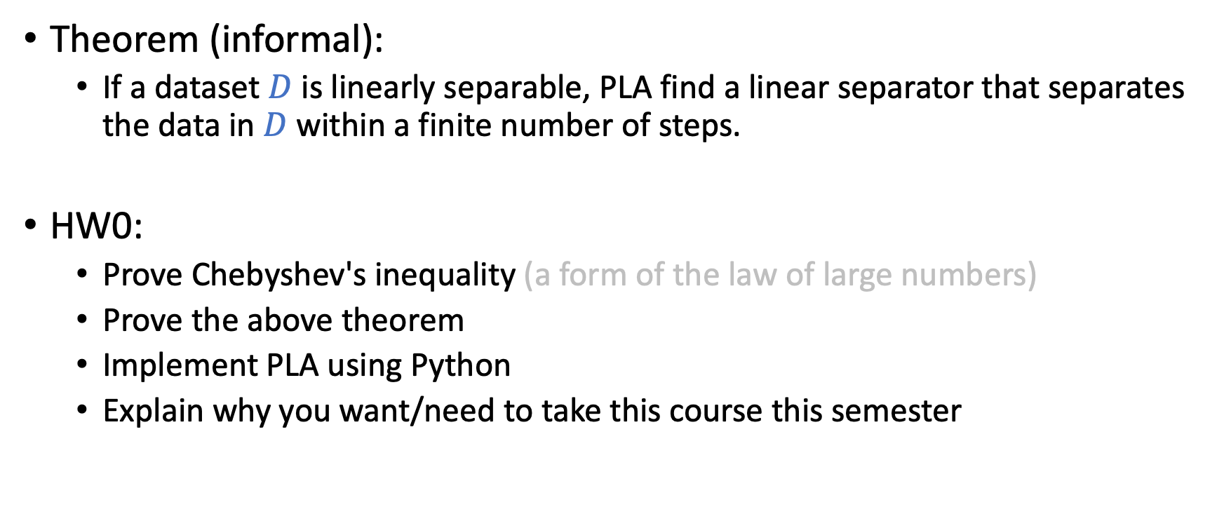
Perceptron Learning Algorithm (PLA)
Theorem (informal):
If a dataset $D$ is linearly separable, PLA find a linear separator that separates the data in $D$ within a finite number of steps.
HW0:
Prove Chebyshev's inequality (a form of the law of large numbers)
Prove the above theorem
Implement PLA using Python
Explain why you want/need to take this course this semester

